Slide 1
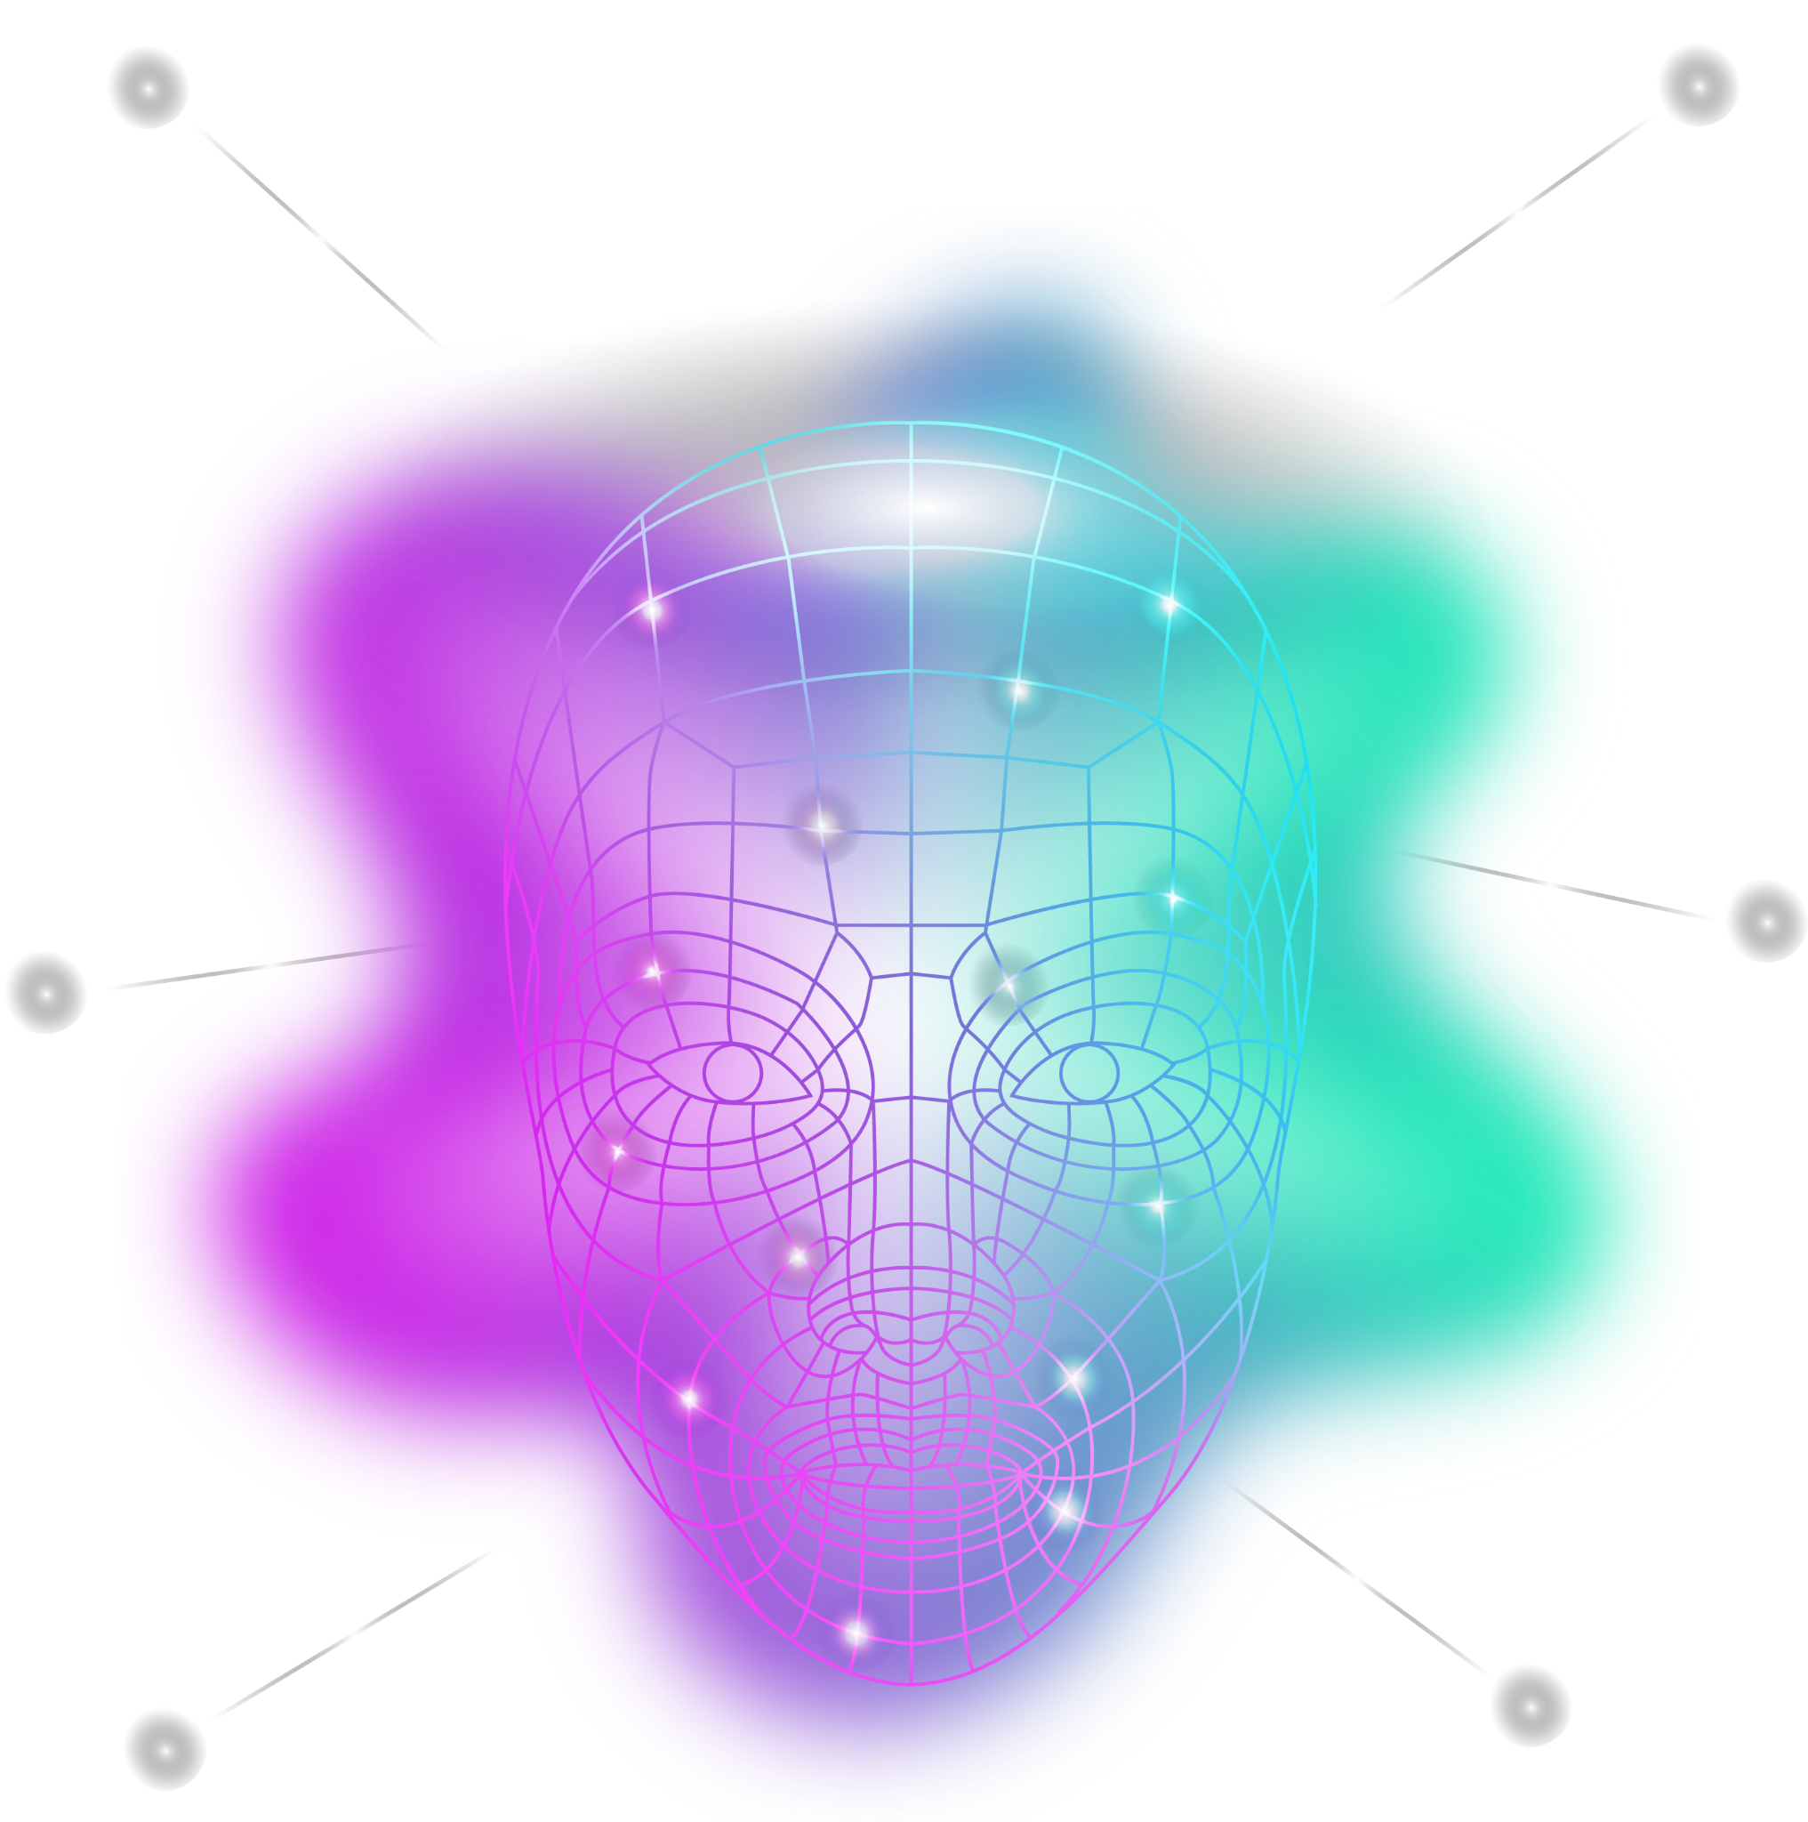
MOODVERSE
SCAN YOUR MOOD, GET THE VIBE
DEVELOPED BY
MD.SAHARIAR HOSEN
ID: 223311156
SECTION: D | 6TH SEMESTER
DEPT. OF CSE
VARENDRA UNIVERSITY

Slide 2



WHY MOODVERSE?
People feel overwhelmed or lonely
Goal: Detect mood & serve content to uplift
No fun way to reflect on mood in real-time

Slide 3



TOOLS & TECHNOLOGY
FRONT-END | BACKEND
NextJS + TypeScript | NodeJS +ExpressJS
TailwindCSS,Framer Motion | MongoDB
Daisy UI | Rest API
 | Python+ OpenCV

Slide 4
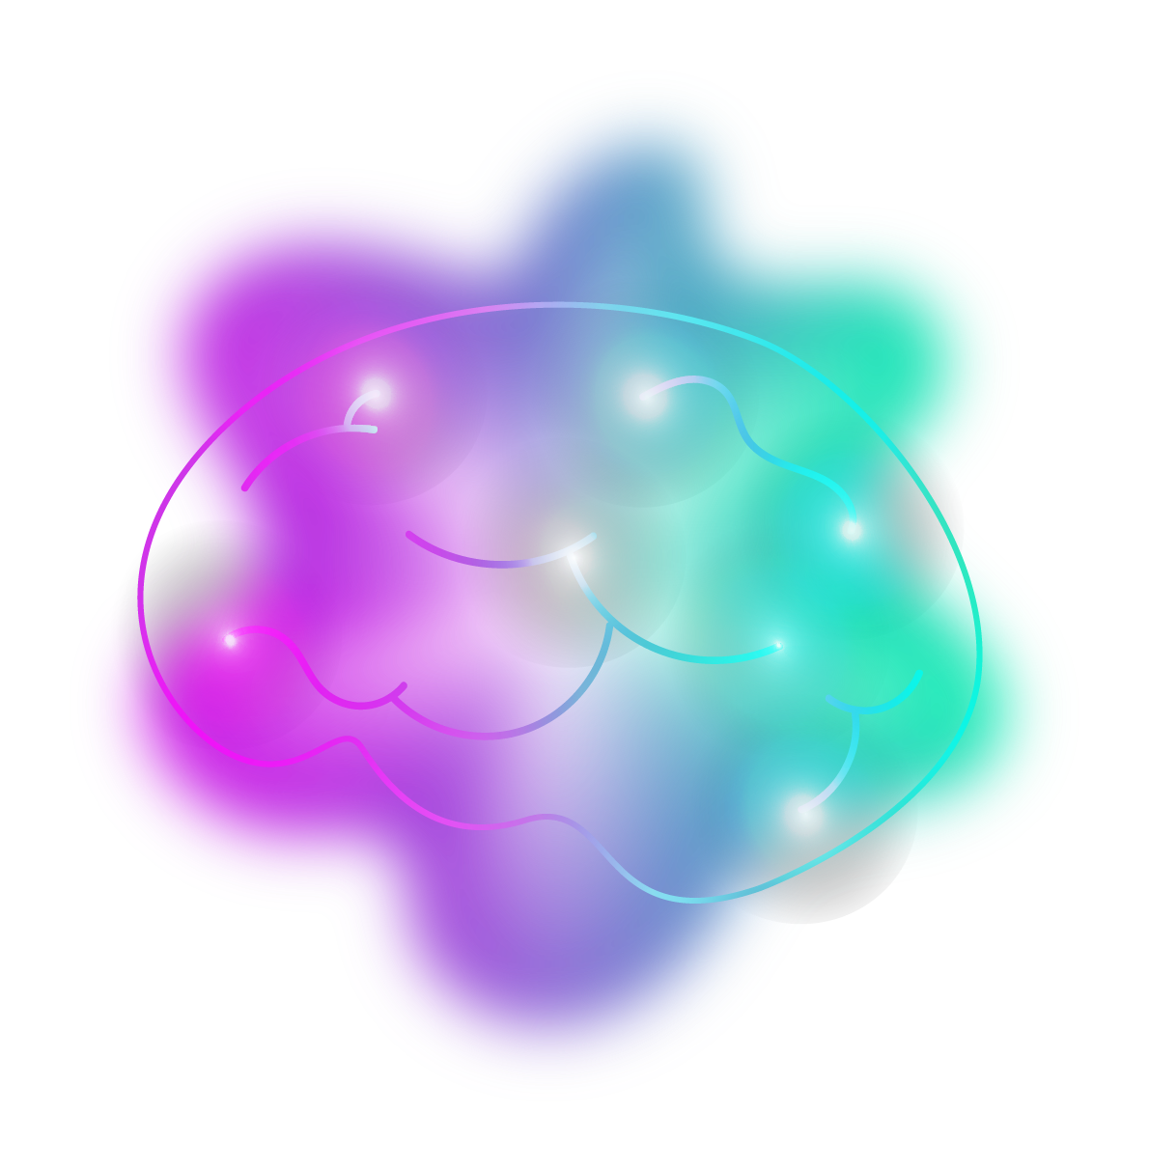
KEY FEATURES
Real-time Mood Detection
Mood History Storage
Name & Age Input Form
Fun Stickers & Neon Frames
Animated Emojis & Reactions
Spotify Music & Memes

Slide 5

HOW IT WORKS?
User inputs name + age
Camera opens and detects mood
Mood data sent to backend
Content fetched via APIs
Mood + timestamp saved to DB

Slide 6
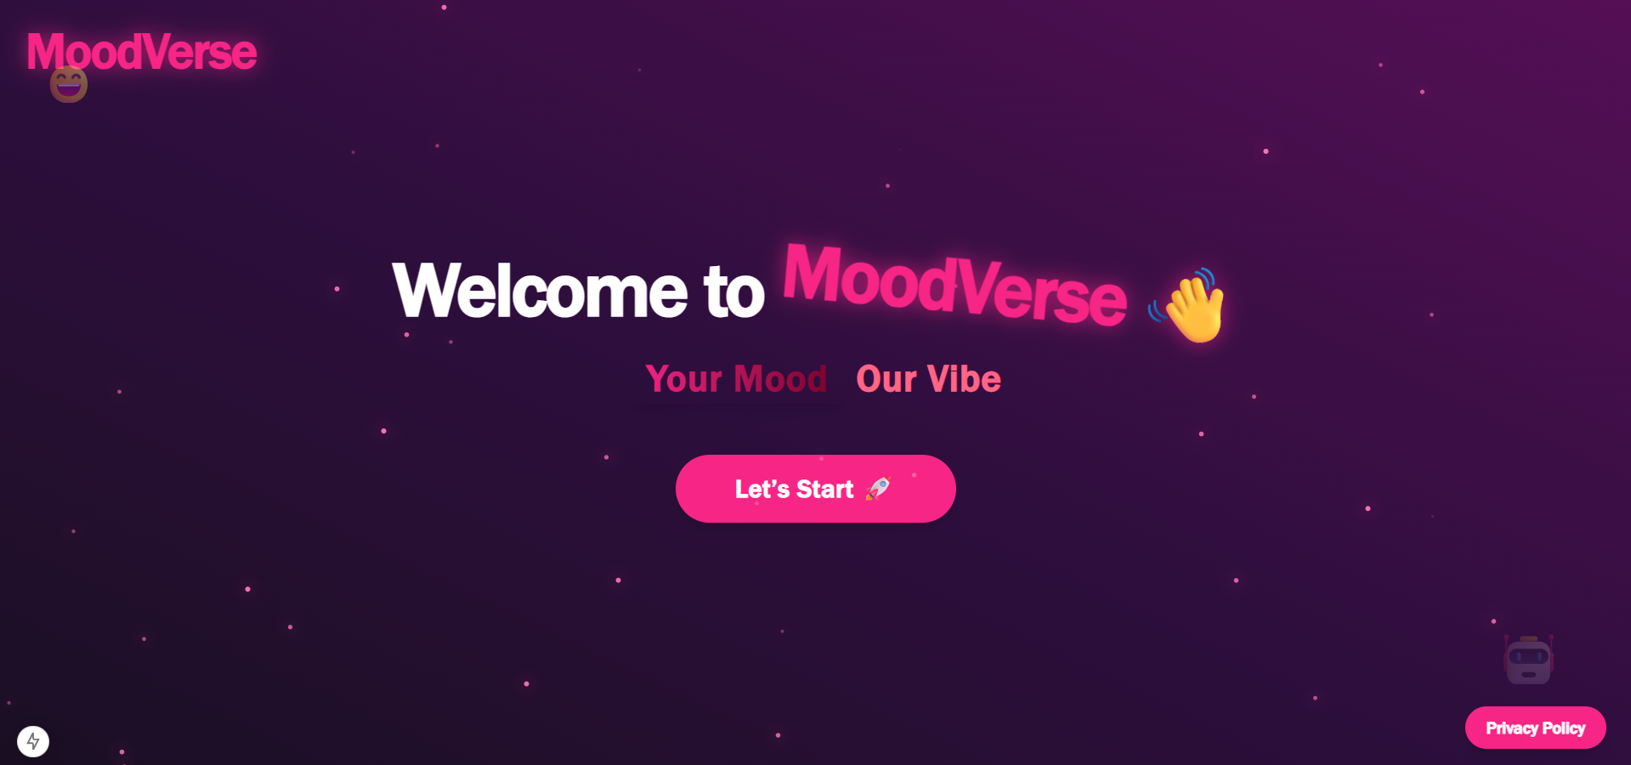
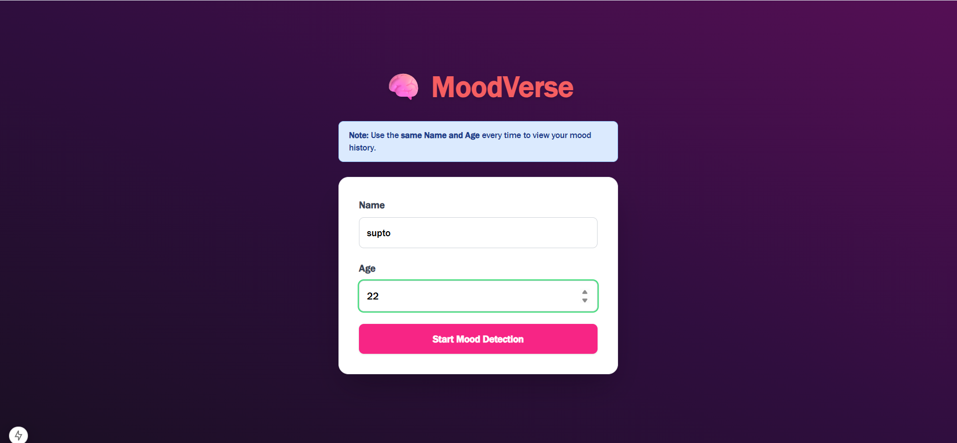
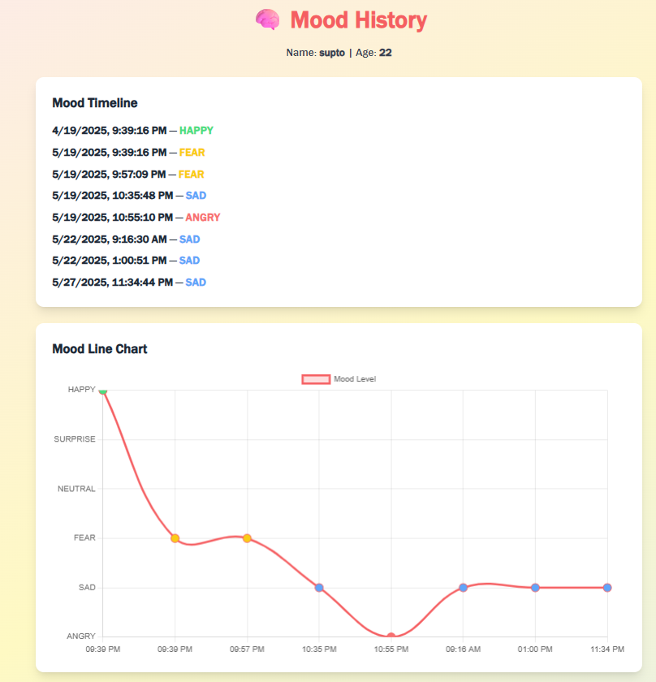
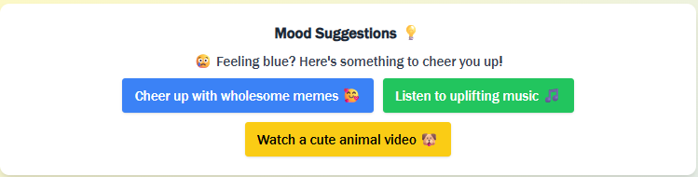
SCREENSHOTS
MOODVERSE LANDING PAGE
START SCAN PAGE
SUUGESTIONS BASED ON RESULTS
MOOD HISTORY

Slide 7
CHALLENGE AND WHAT NEXT?
Faced:
- Browser camera access issues
- Model misdetecting neutral/sad
- Accuracy
Future:
- Add dark mode & Bengali UI
- Real-time mood analytics
- AI therapist/chat support
- Live hosting

Slide 8
Thanks for Your Time
THE END

